Slide 1
Course Selection Steps
for Students
Choosing, Reviewing, and Submitting your courses with myBlueprint
Contact Us
www.myBlueprint.ca
support@myBlueprint.ca
1-888-901-5505

Slide 2
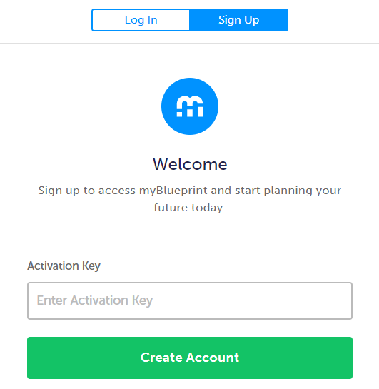
Create your own myBlueprint Account via www.myBlueprint.ca Depending on your school, you will either enter an
Activation Key or select your school from a drop down menu
Notes:
Note for counsellors:
Your school board/division may have it’s own myBlueprint landing page, which includes a list of schools in the New User box. If you’re not sure whether your school has a landing page or an activation key, contact support@myBlueprint.ca

Slide 3
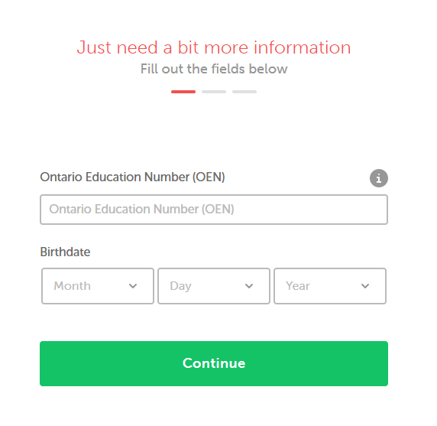
Enter your Provincial Education Number (OEN, ASN)
and Date of Birth Note: This 9-digit number can be found on your report card

Slide 4
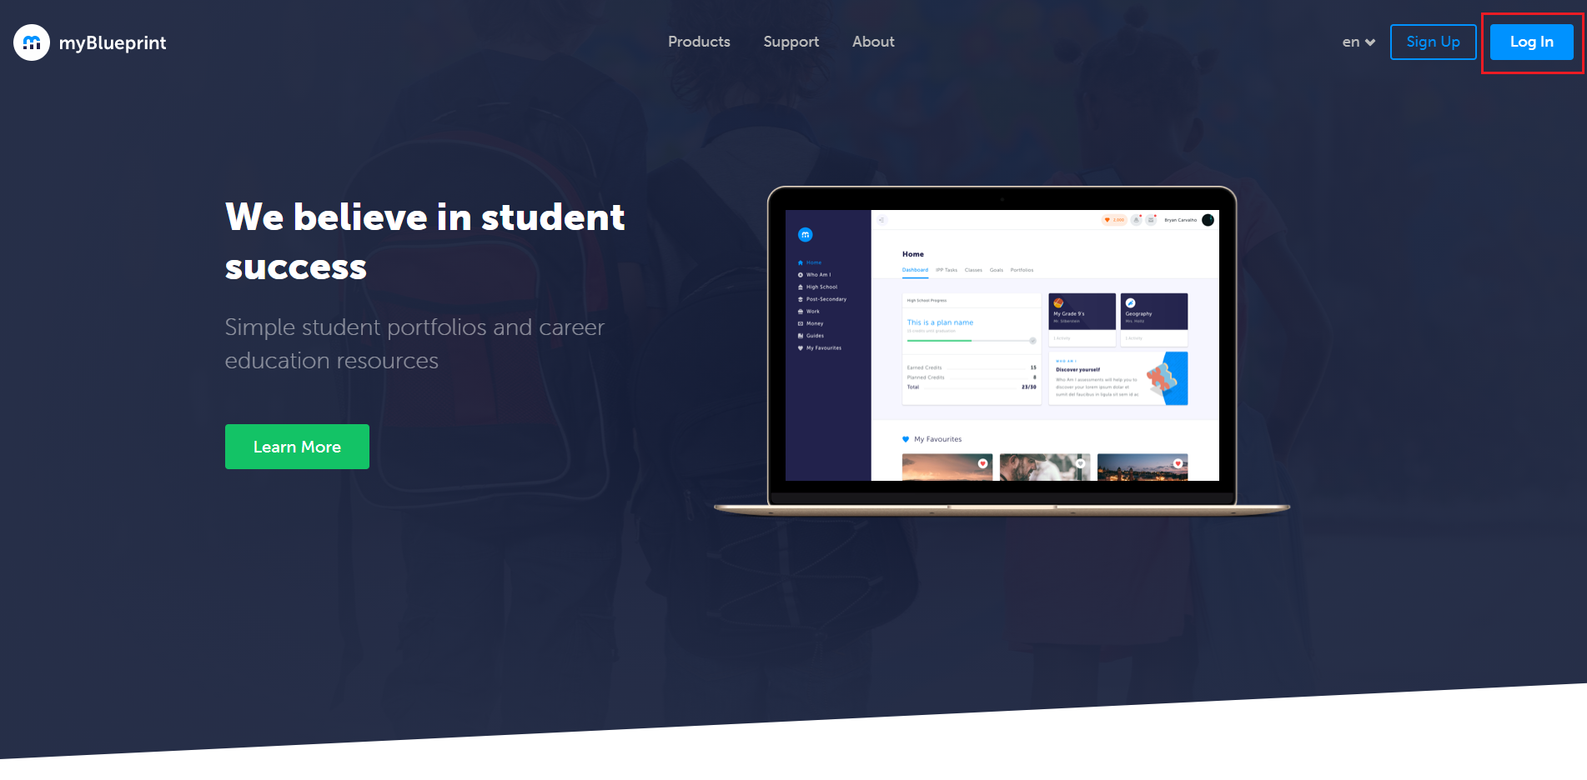
STEP 1: Login to your myBlueprint account via
The Log In button

Slide 5
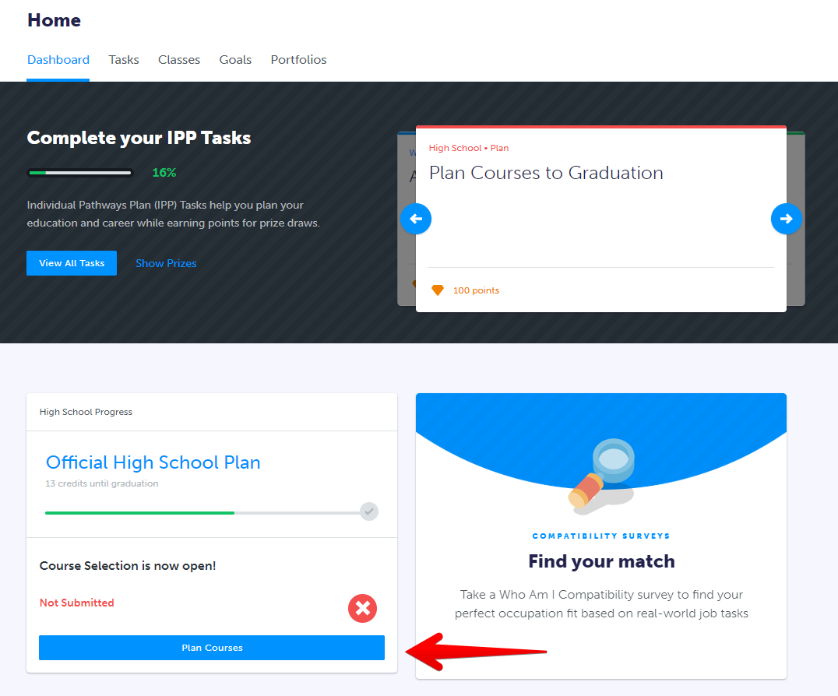
STEP 2: From the Dashboard, click on Plan Courses

Slide 6
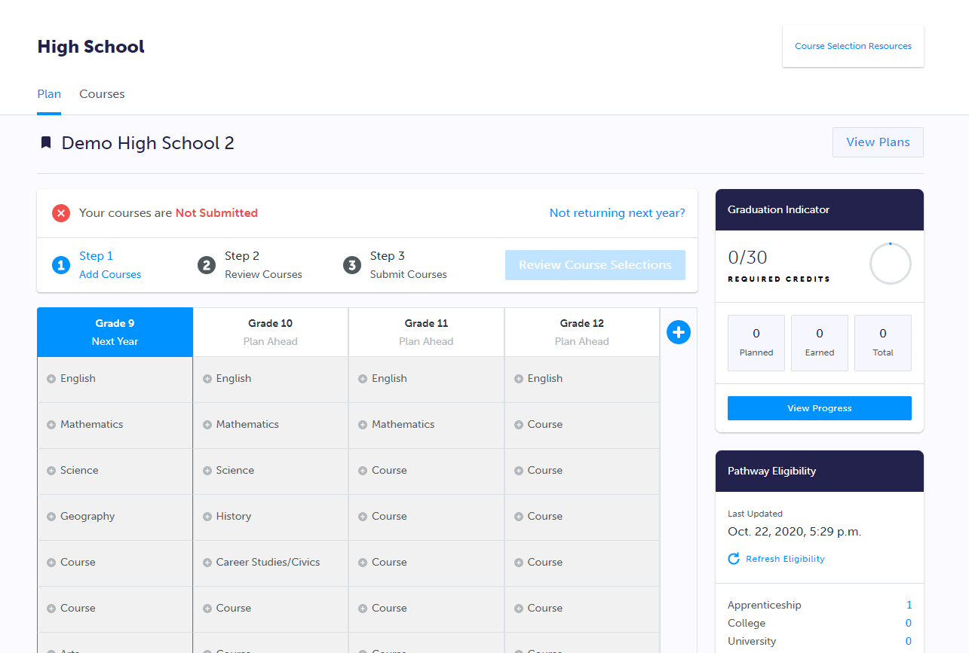
STEP 3: Add courses to your High School Plan. Click on + Course to select from courses at your school.
Notes:
Note for counsellors:
Compulsory courses are indicated by + Subject (ie. + English)
Boxes for elective courses are indicated by + Course

Slide 7
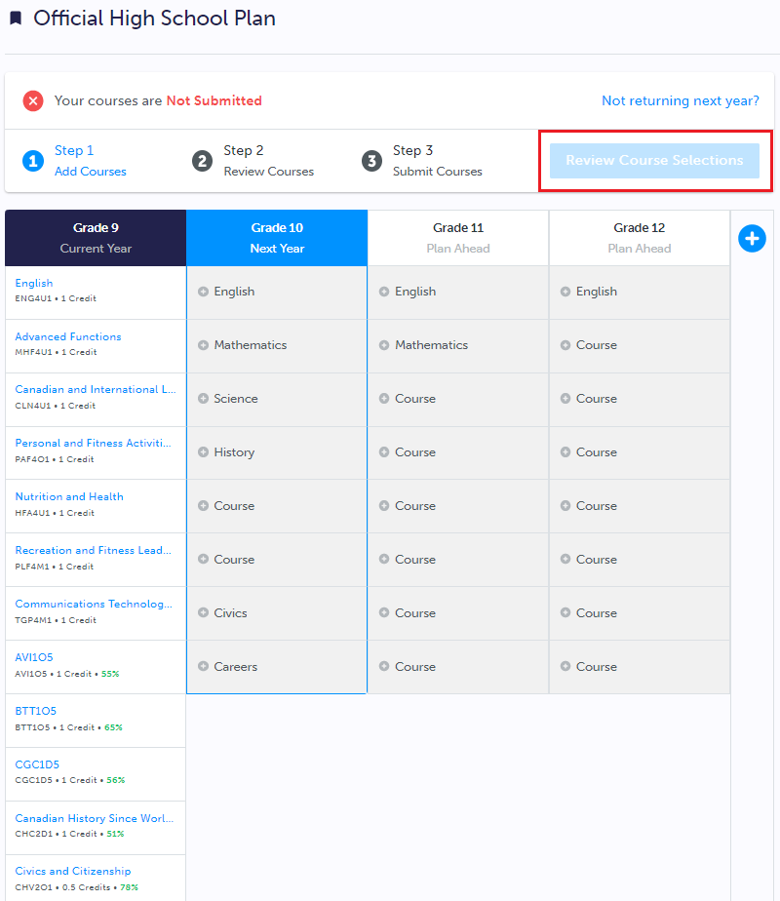
STEP 4: Click on Review Course Selections to review your chosen courses

Slide 8
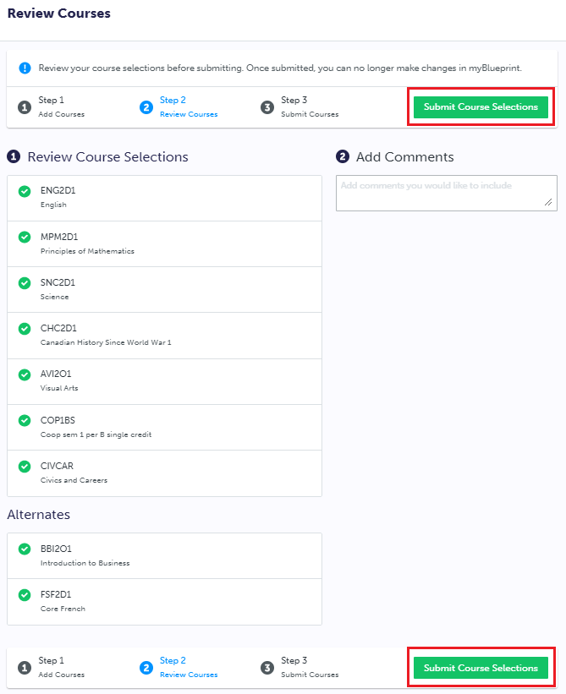
STEP 5: Click Submit Course Selections to submit courses to your school
Notes:
Note for Counsellors:
You may have enabled additional fields such as Student Comments, or Pathway of Interest. If so, students will find these options here.

Slide 9
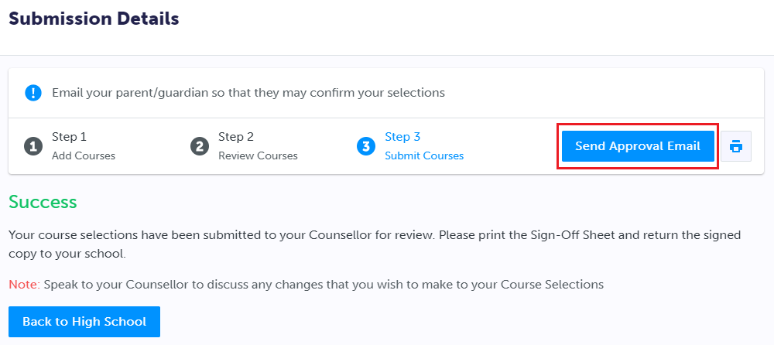
STEP 6: Click Send Approval Email
Notes:
Note for counsellors:
You can disable the sign off sheet under Configure Course Selection settings in your account. If so, you can remove this slide.

Slide 10
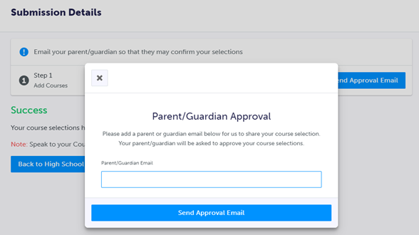
STEP 6: Enter Parent/Guardian Email

Slide 11
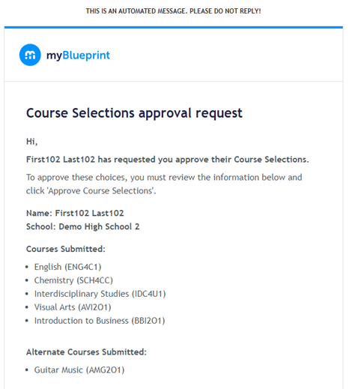
STEP 6: Parent/Guardian can Approve or Reject

Slide 12
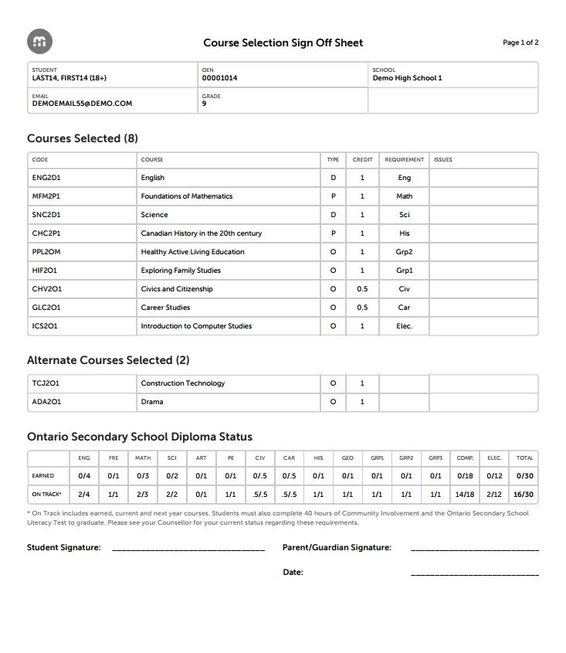
STEP 7: Optionally print your Sign-Off Sheet
Notes:
Note for counsellors:
You can disable the sign off sheet under Configure Course Selection settings in your account. If so, you can remove this slide.

Slide 13
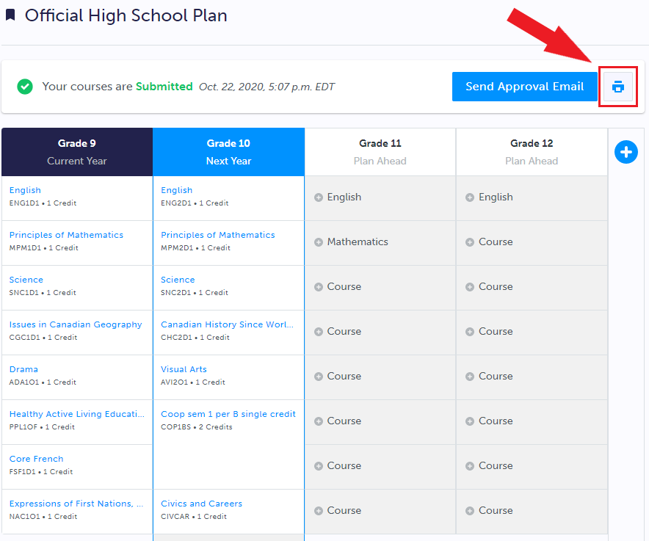
STEP 7: Print your Sign-Off Sheet
Note: You can reprint this form at any time from the
High School section of your account
Notes:
Note for counsellors:
You can disable the sign off sheet under Configure Course Selection settings in your account. If so, you can remove this slide.

